Slide 1


MICROVASCULAR IMAGE GUIDED
TREATMENT OF ARTHRITIS
ROBERT BARD, MD, DABR, FAIUM, FASLMS
Director, Bard Diagnostic Imaging
THE ANGIOFOUNDATION 501(c)3, NYC
Founder
SOCIETE FRANCAISE DE RADIOLOGIE, PARIS
International Contributor
©Copyright 2024 - Robert. L. Bard, MD. All Rights Reserved.

Slide 2

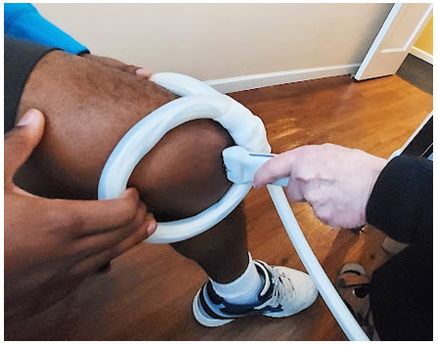
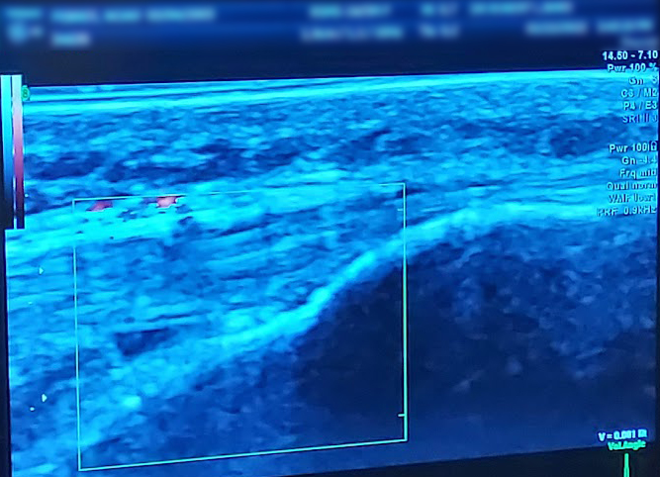
EARLY ARTHRITIS IN THE KNEE
Use of 3D Ultrasound allows the monitoring of EARLY ARTHRITIS in Athletes. The joint may become stiff and swollen, making it difficult to bend and straighten the knee. Pain and swelling may be worse in the morning, or after sitting or resting. Use of PEMF or Pulsed Electromagnetic Frequency treatment may bring relief and cell regeneration to restore knee performance.

Slide 3
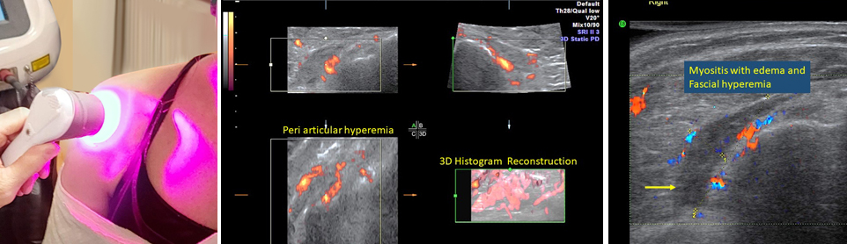
RHEUMATOID ARTHRITIS IN SHOULDER
Pathological Reaction to Foreign Vaccination
Rheumatoid arthritis (RA) is a long-term health condition that mainly affects your joints. It usually brings on pain and swelling in many joints at once, often in the hands, wrists, and knees. Through the use of near-infrared therapy or Photobiomodulation has shown significant restorative results and pain relief.

Slide 4
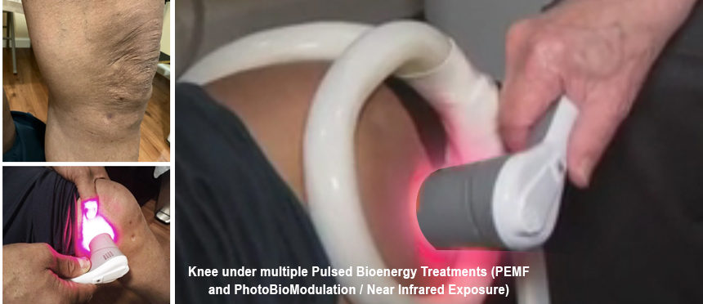
NON-INVASIVE TREATMENT OF POSTOP TEAR IN MEDIAL MENISCUS

Slide 5
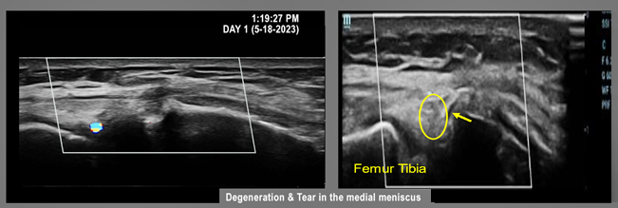
NON-INVASIVE TREATMENT OF POSTOP TEAR IN MEDIAL MENISCUS
DAY 1 SCAN: BASELINE L KNEE (BEFORE TREATMENT)
Subject received scan of postoperative meniscus indicating a measureable tear in the medial meniscus. In the inferior section of the medial meniscus, the echo pattern changes from white to gray with some black spaces of fluid (right) against the medial tibial articular surface, which is indicative of a fluid filled space representing either a small cyst or a tear in the meniscus that is filled with fluid.

Slide 6
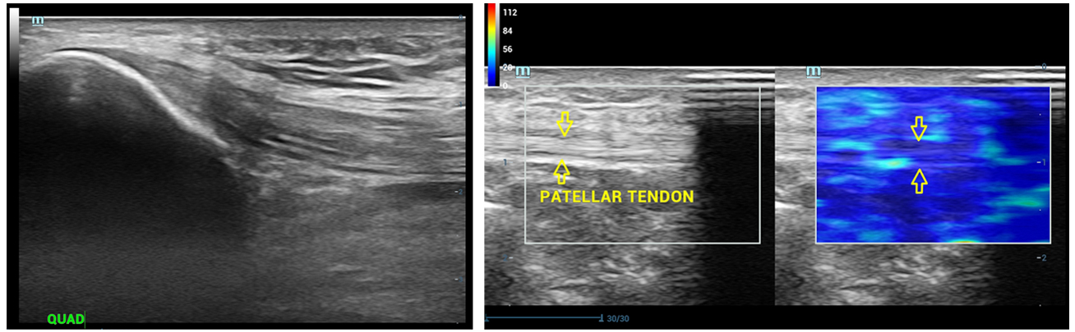
NON-INVASIVE TREATMENT OF POSTOP TEAR IN MEDIAL MENISCUS
FINAL DAY AFTER MULTIPLE TREATMENTS
This is a comparison of the normal right knee with the abnormal right knee, which has showed mark remarkable healing in the postoperative medial meniscus area as shown by the elastogram, which is light blue, used to be red after one month of treatment with pulse energy treatments.

Slide 7
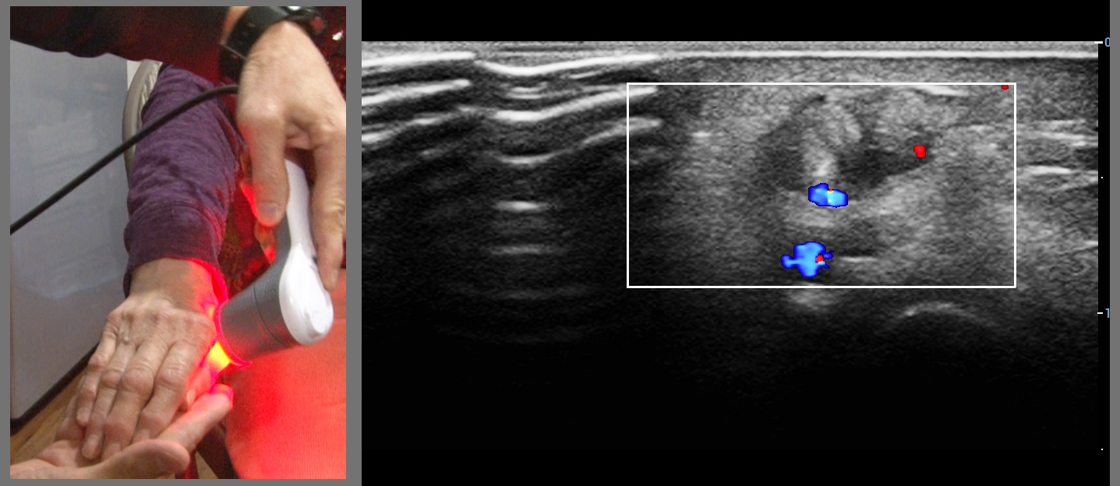
RHEUMATOID ARTHRITIS / R HAND
Subject expressed diminished pain after treatment, also demonstrating increased flexibility of thumb. Use of near infrared therapy brought measurable relief to patient + significant reduction in inflammation via Doppler Blood Flow ultrasound.

Slide 8
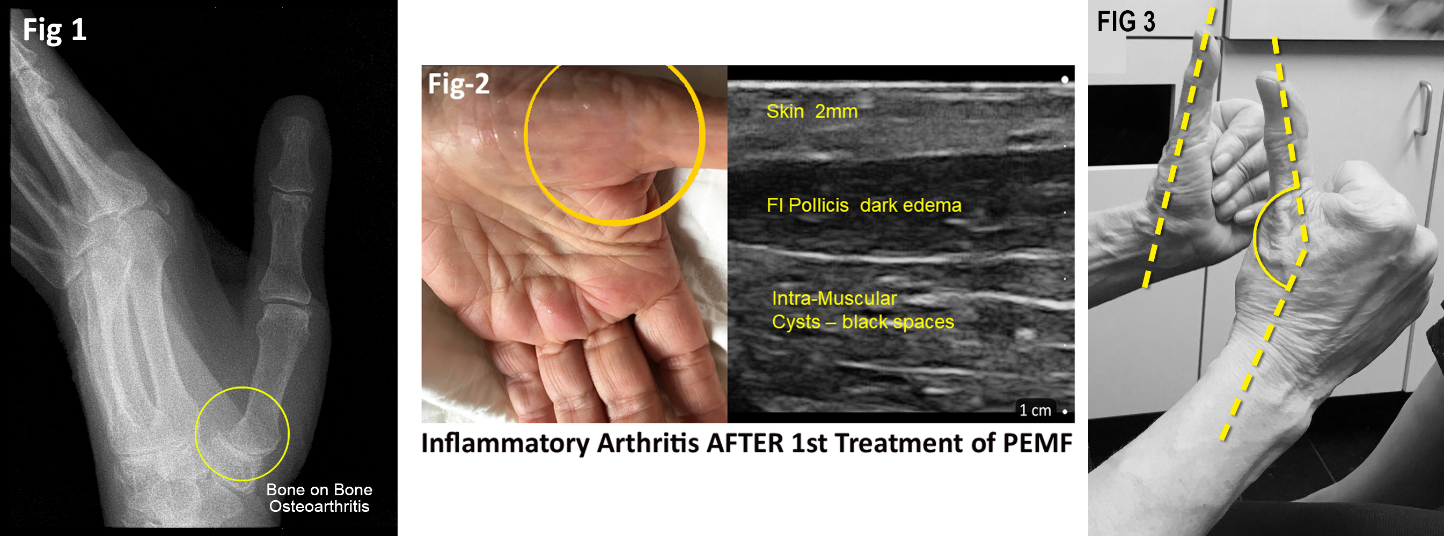
OSTEOARTHRITIS IN THE HAND: OBSERVED RESPONSE TO PEMF
Before/after treatment by one month induced treatment of the PEMF appears to show decreased inflammatory response or a possible increase the body's healing function to reduce the inflammatory fluid in the joint space. Theoretical improvement in mitochondrial function from PEMF performance reports.

Slide 9
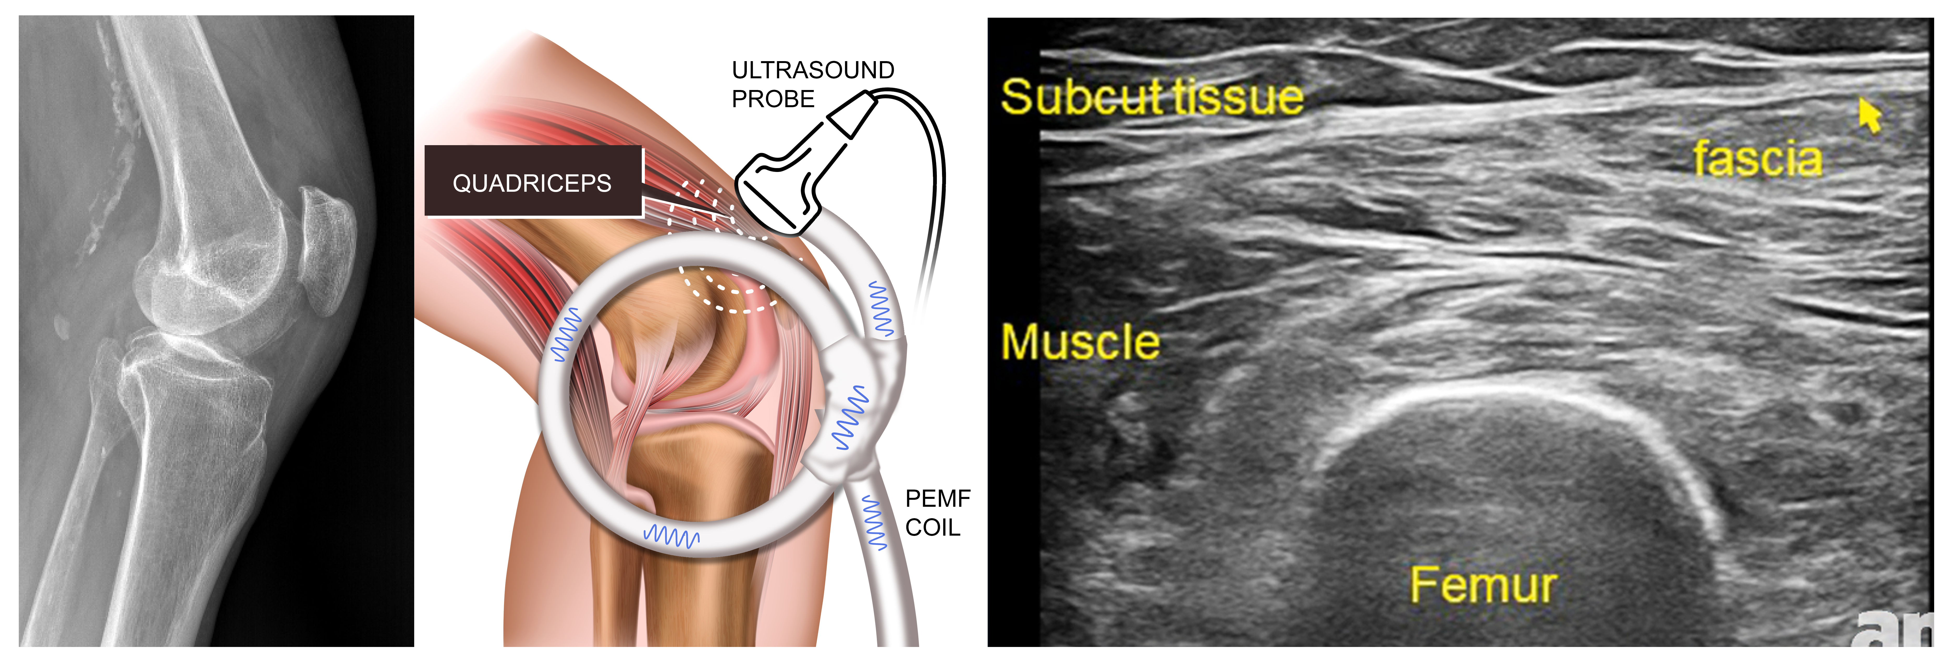
INDUCTION OF NEUROSTIMULATION IN
INFLAMMATORY DISEASE IN MSK
“Scan and Treat”- image guided treatment of real-time ultrasound monitoring of MSK therapy

Slide 10
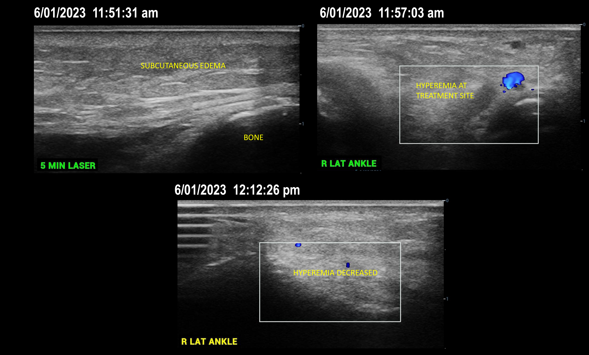
EDEMA/ KNEE & ANKLE
Traumatic injury with swelling of the patella and media left knee

Slide 11
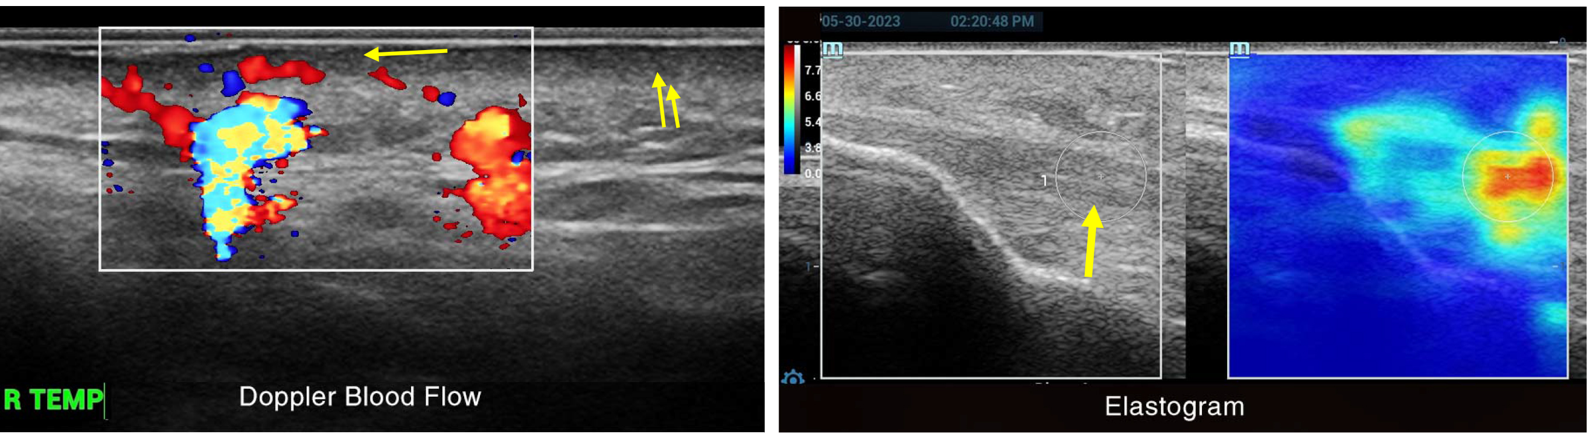
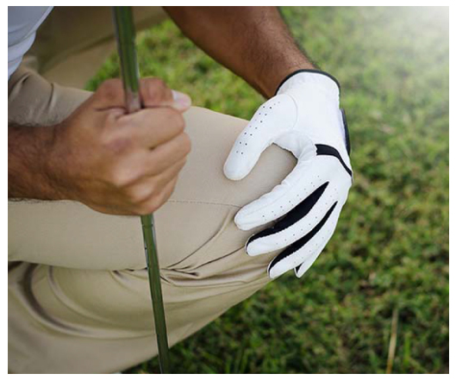
RESTORING GOLFER’S KNEE
RHEUMATOID ARTHRITIS / FIBROMYALGIA
Inflammatory disease involves the skin, joints, tendons, arteries and many solid organ systems. The insertion of the quadriceps tendon onto the superior patella surface shows dark edema at the attachment and it shows white echogenic fibrosis two centimeters proximal Image of the temporal area to measure arterial and autonomic nervous system response to the energy input shows that the upper 1mm of the 2 mm dermis is dark (single arrow) and the inflamed area has measurable inflammatory vessels (double arrow)

Slide 12
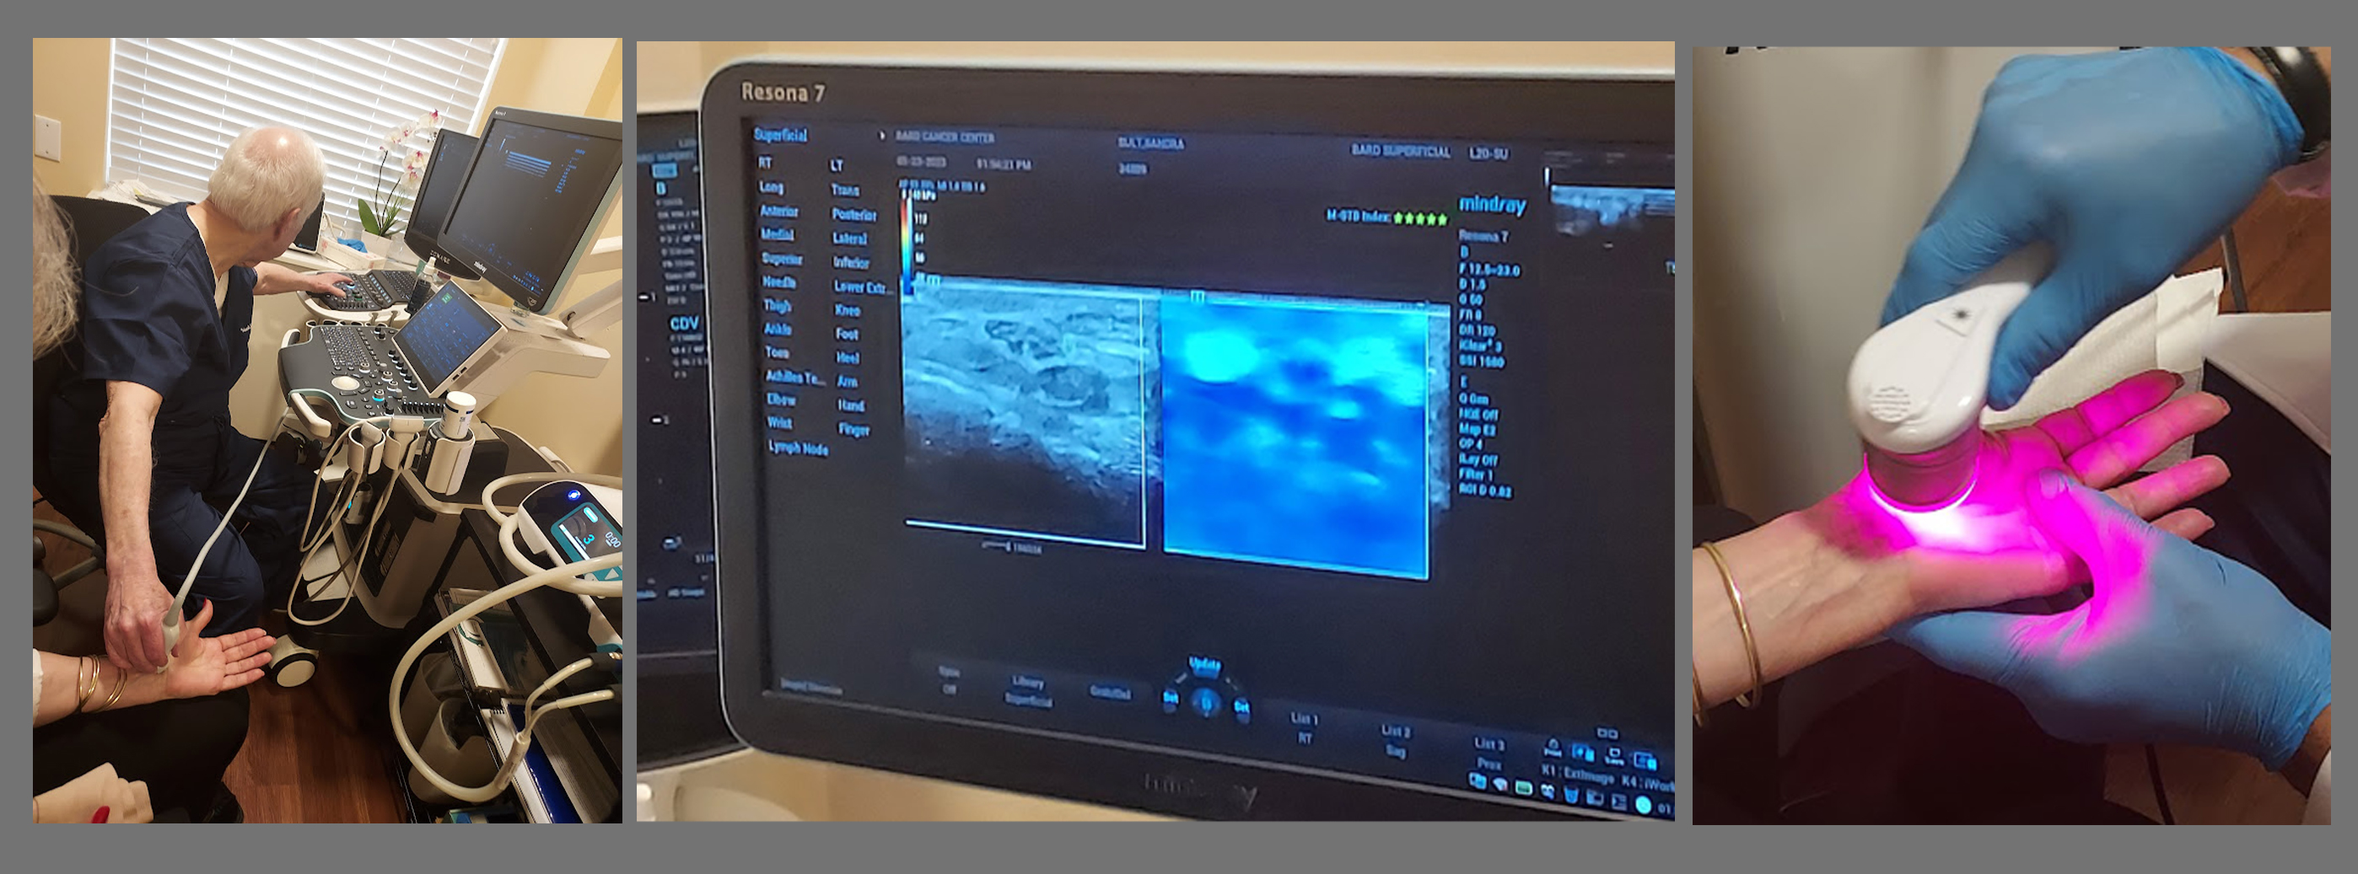
EDEMA OF MEDIAN NERVE REDUCED

Slide 13
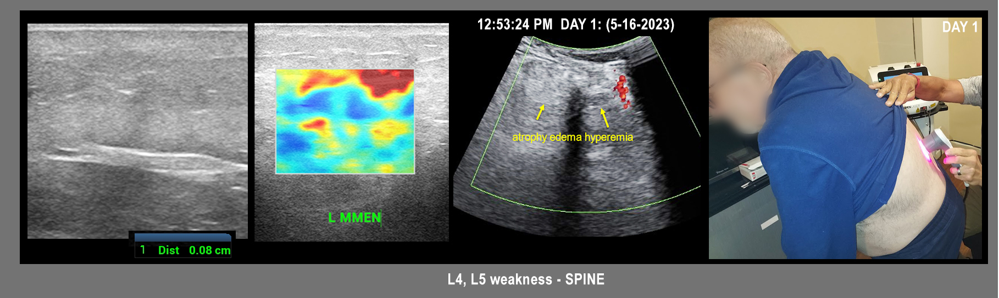
SACROILLIAC JOINT INFLAMMATION
Shoulder arthritis is inflammation in your shoulder joint. Over time, arthritis leads to cartilage loss. Symptoms include pain, stiffness, decreased range of motion and popping, clicking and grinding noises in your shoulder joint.

Slide 14
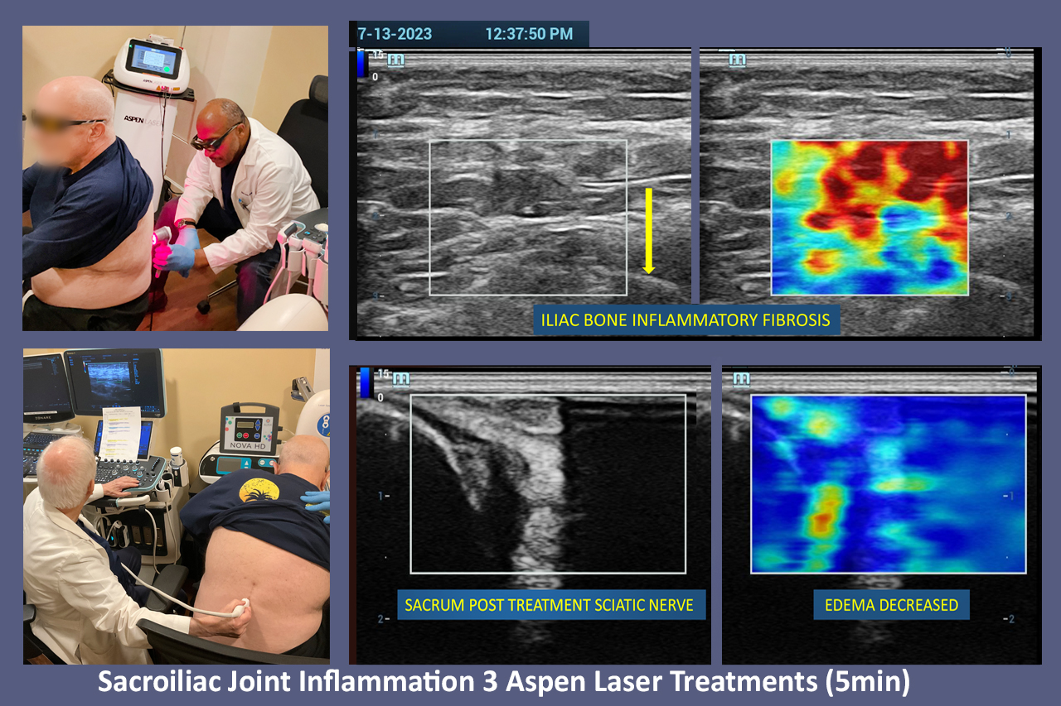
SACROILLIAC JOINT INFLAMMATION: Advanced Laser Modulation

Slide 15
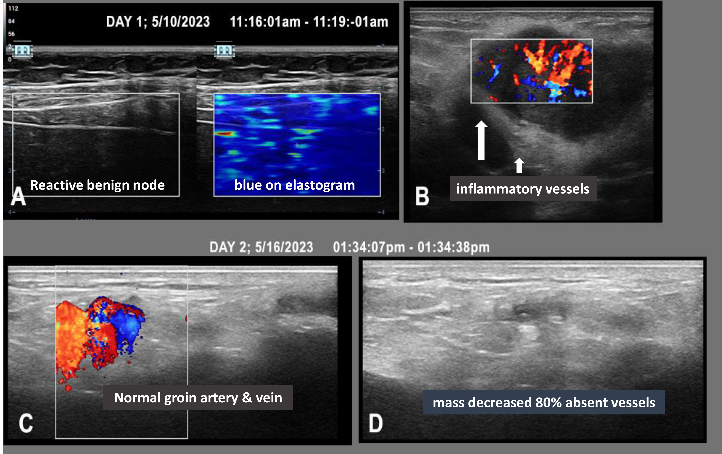
PAINFUL MASS / GROIN AREA
60 year old female with a painful mass in the groin. The sonogram with Doppler shows inflammatory vessels in the gland and the elastography confirms a mean of 16 out of 140 kilopascals indicating an inflammatory nature.

Slide 16
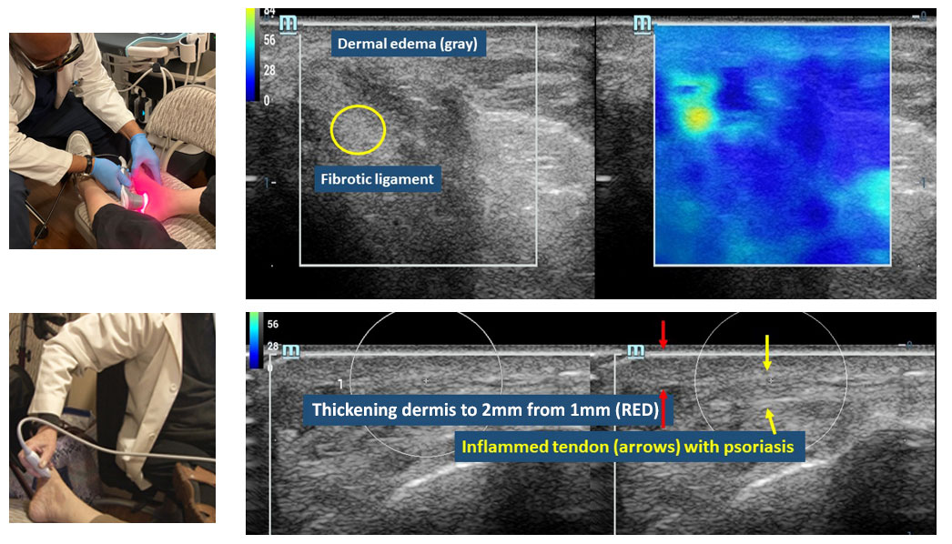
PSORIASIS / FOOT & ELBOW

Slide 17
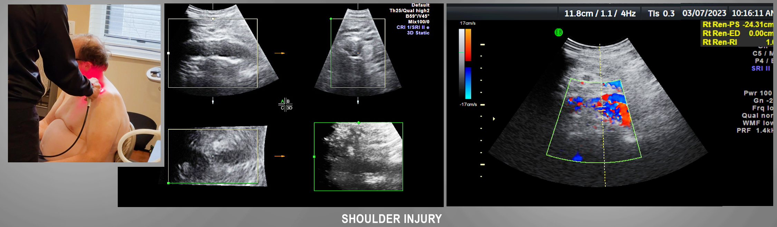
SHOULDER ARTHRITIS DUE TO AVASCULAR NECROSIS
Shoulder arthritis is inflammation in your shoulder joint. Over time, arthritis leads to cartilage loss. Symptoms include pain, stiffness, decreased range of motion and popping, clicking and grinding noises in your shoulder joint.

Slide 18
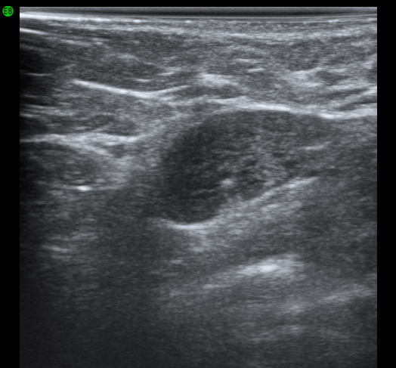
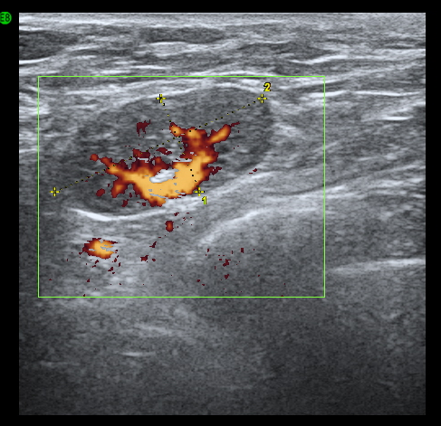
INFLAMMATORY ADENOPATHY
AXILLARY NODE ENLARGING AFTER BEE STINGS TO ARM
RIB CAGE

Slide 19
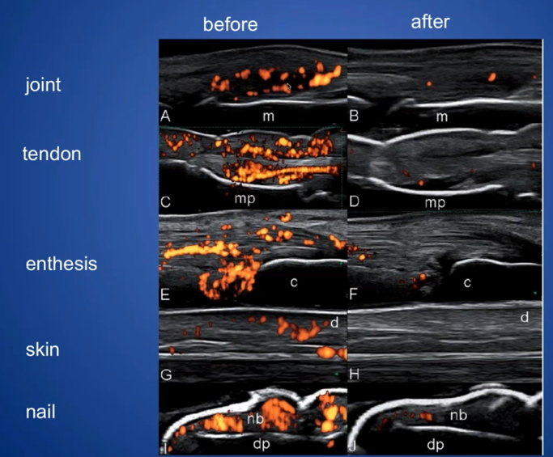
PSORIASIS TREATMENT FOLLOW-UP

Slide 20
EN FACE OCT PSORIASIS
PRE RX
VESSEL
DENSITY
PRE RX
CELL MATRIX
POST RX
VESSEL
POST RX
CELL MATRIX

Slide 21
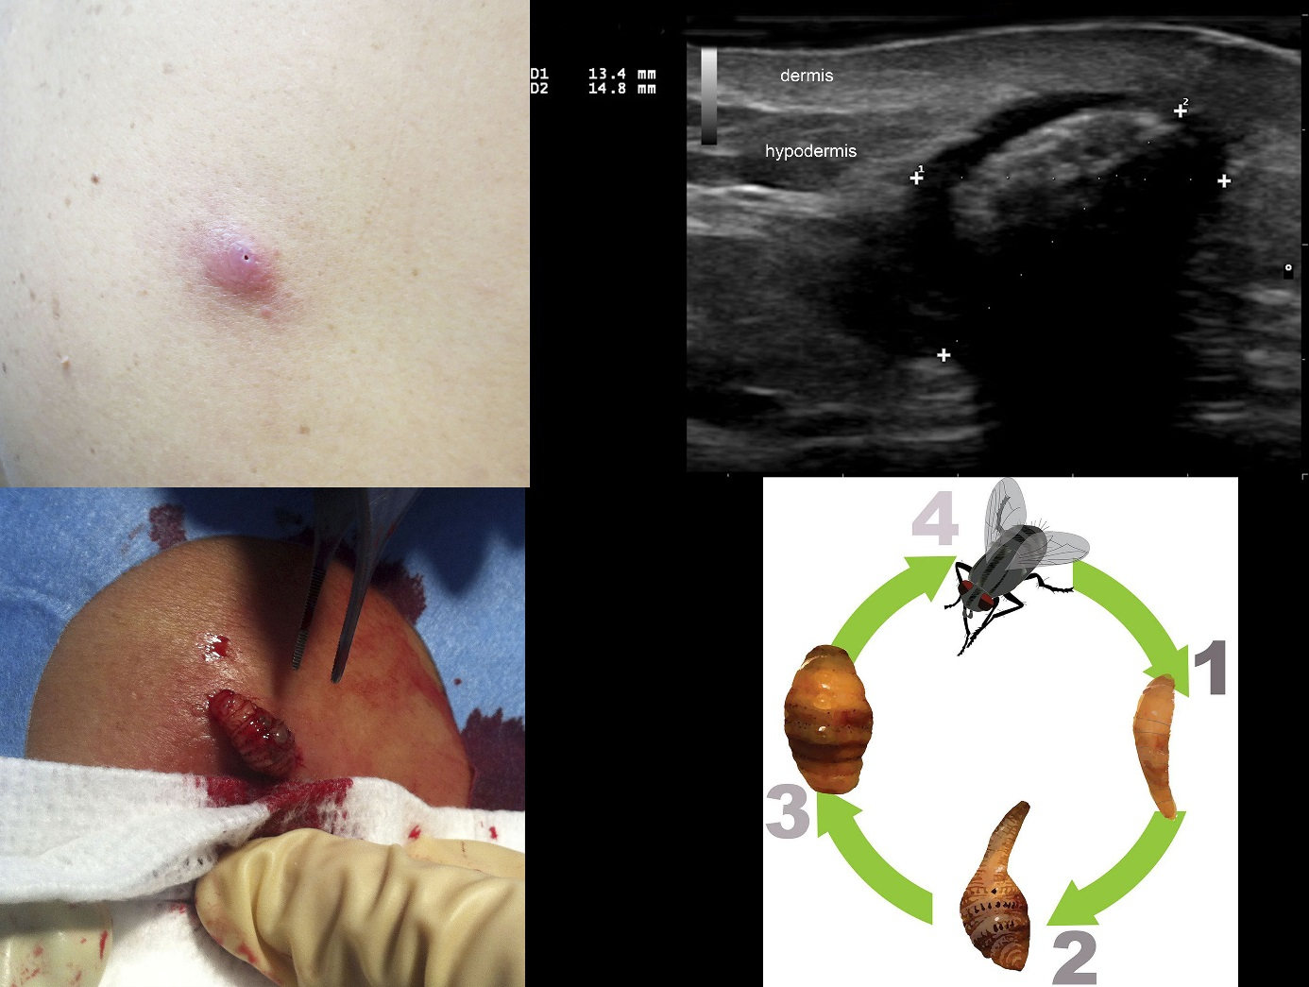
DERMATOBIA HOMINIS MYIASIS
HUMAN BOTFLY CAUSES PARASITIC SUBDERMAL INFESTATION
Doppler can show motion of larva verifying viability
LARVAL IMAGE
LONGITUDINAL

Slide 22
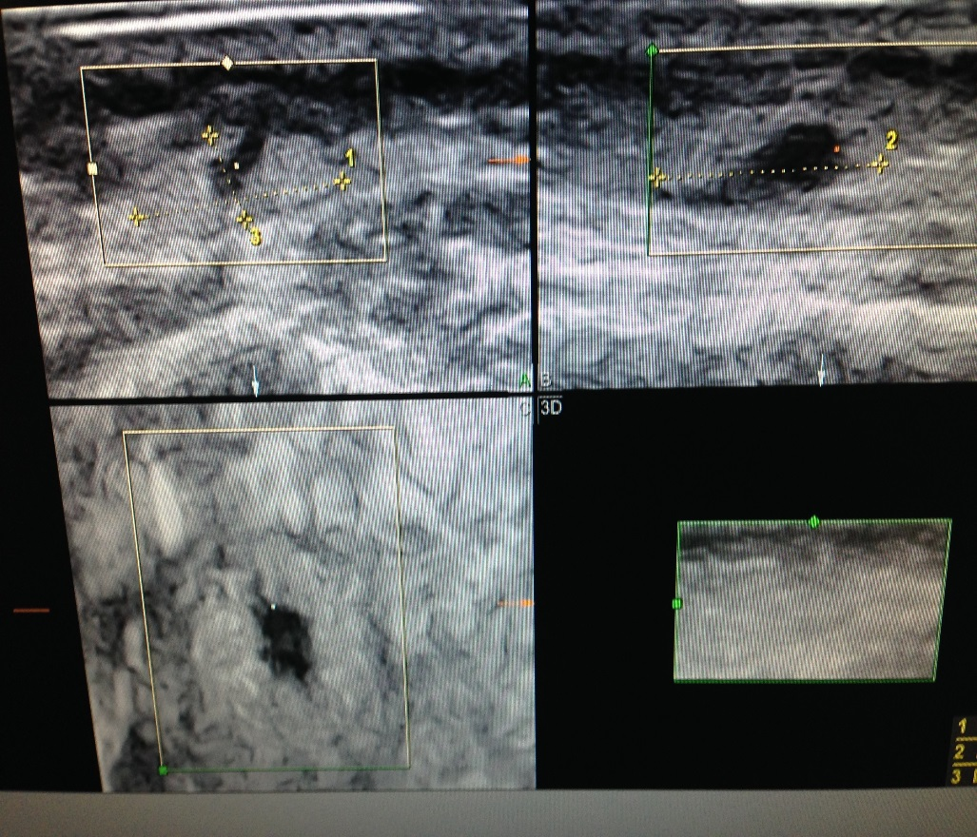
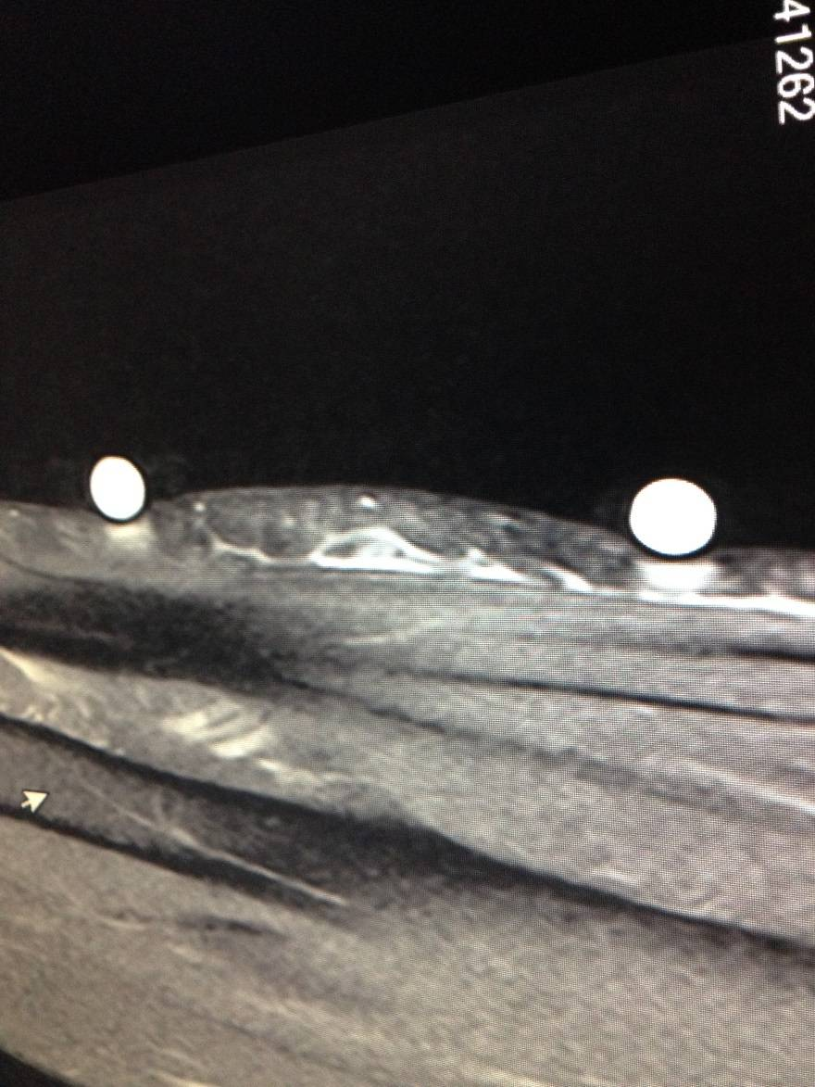
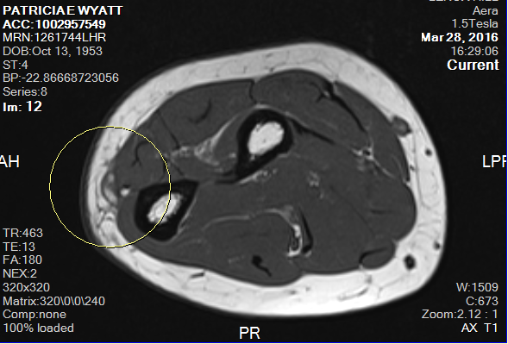
FAT NECROSIS
SONOGRAM .5 T MRI
SONOGRAM .5 T MRI
2D
3D
T2
T1
VOLAR FOREARM 3 WEEKS POST LIPOSUCTION

Slide 23
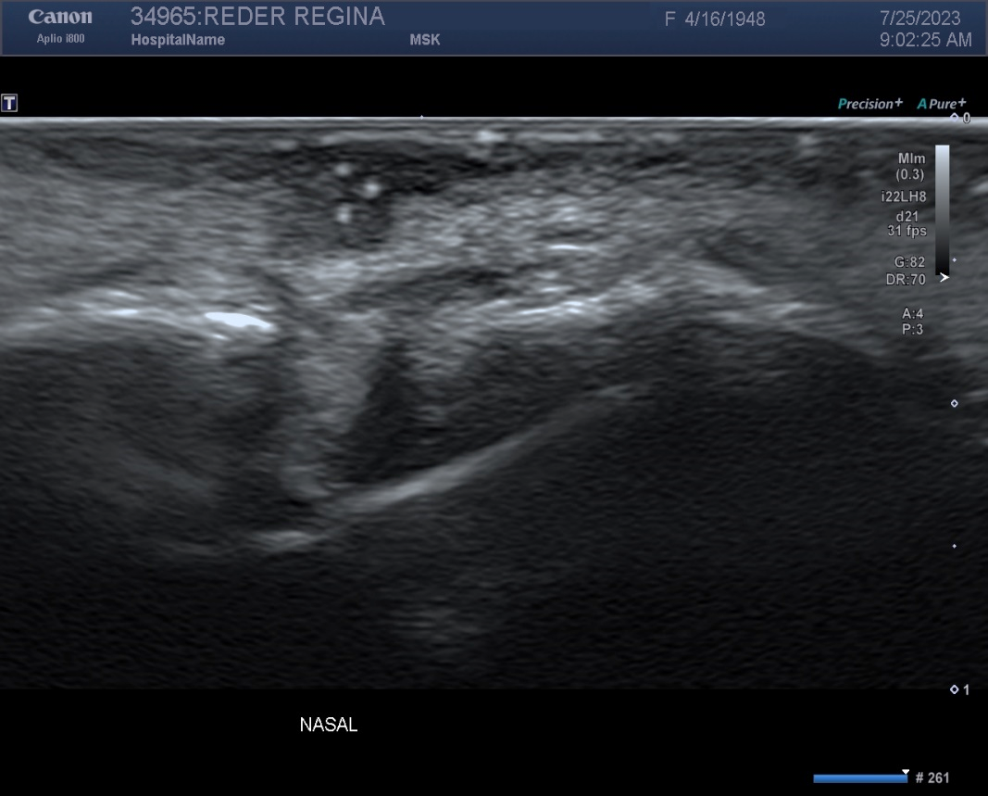
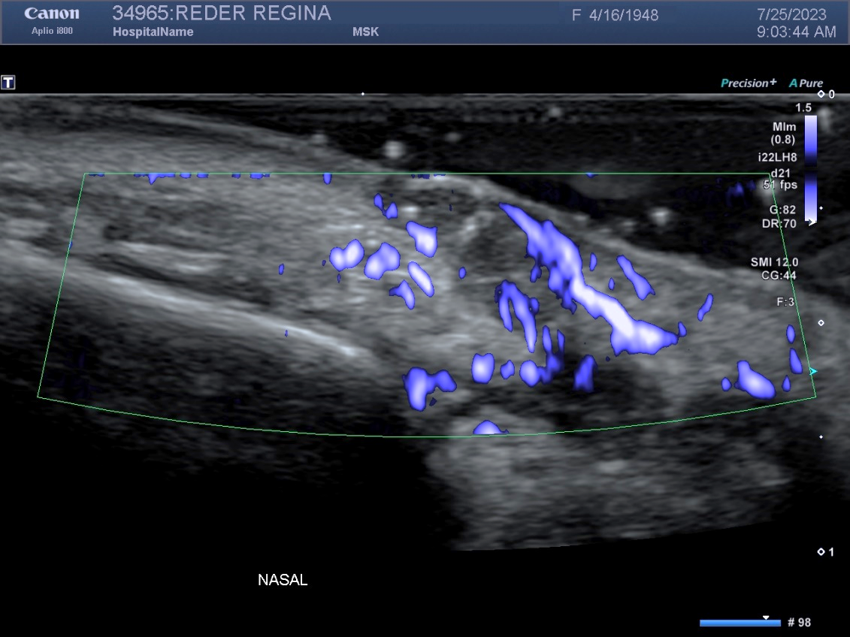
RECURRENT NASAL BCC - 2MM
WHITE DOTS + NEOVASCULARITY = HIGH GRADE
Cartilage
Invasion

Slide 24
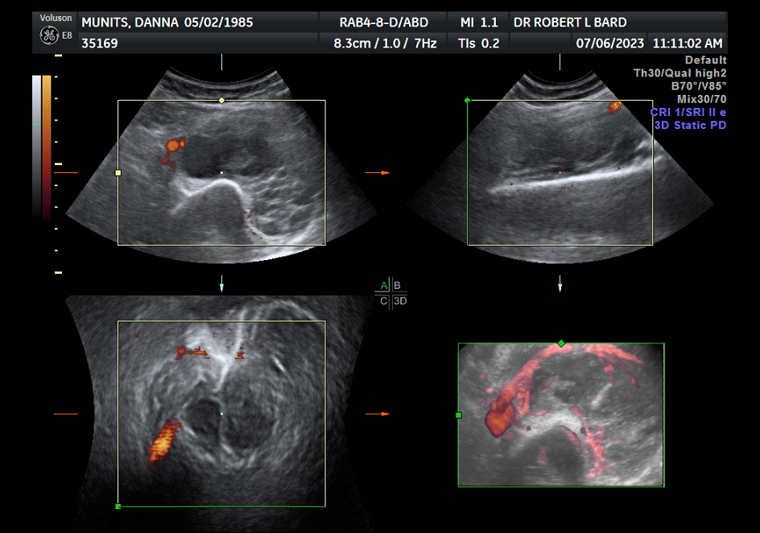
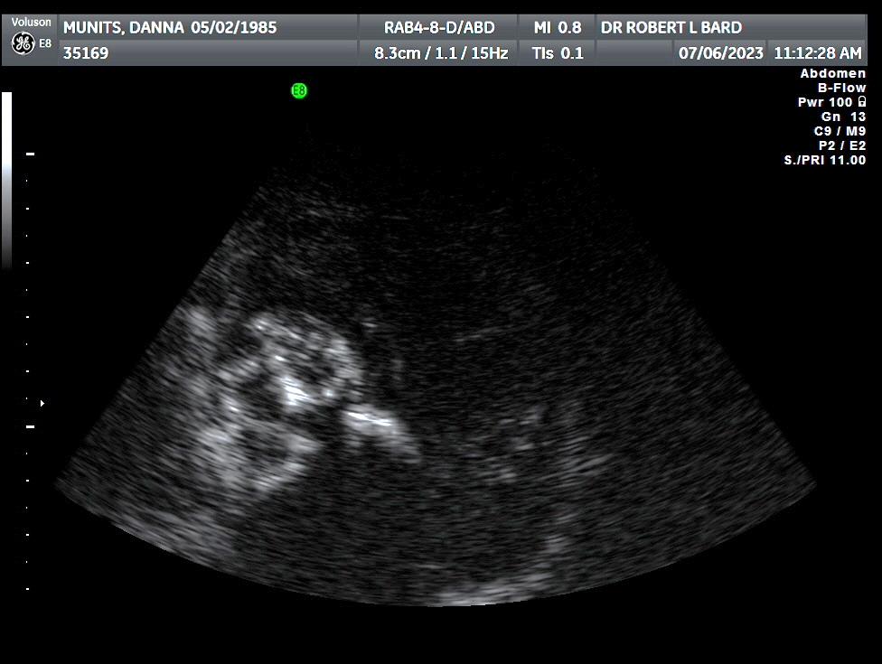
CHONDROSARCOMA INVADING FEMUR AND RECTUS MUSCLE
3-D Doppler of neovascularity Bone invasion arrow B-flow of tumor angiogenesis
muscle
invasion

Slide 25
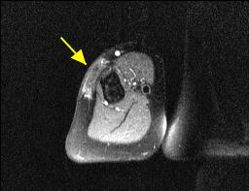
FAT NECROSIS
VESSEL (RED) CORRESPONDS TO HYPEREMIA ON MRI - INFLAMMATION
SKIN MRI
humerus
HERPES VACCINE-9 MONTHS PAINLESS DEFORMITY UPPER HUMERUS

Slide 26
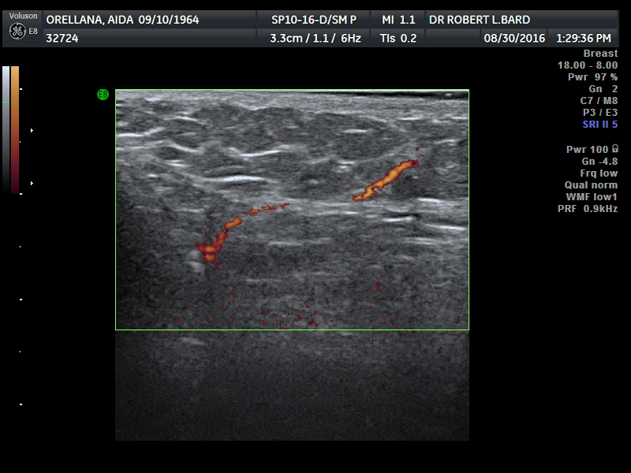
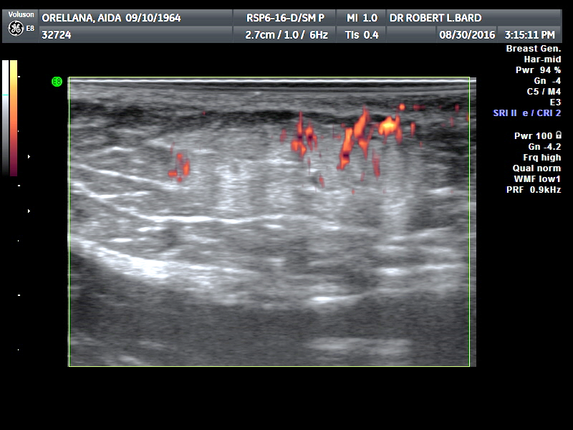
FAT CLOUD = EFFECTIVE TREATMENT
THERMAL INJURY CAUSING NEOVASCULARITY AND CLOUDY ECHOGENICITY

Slide 27
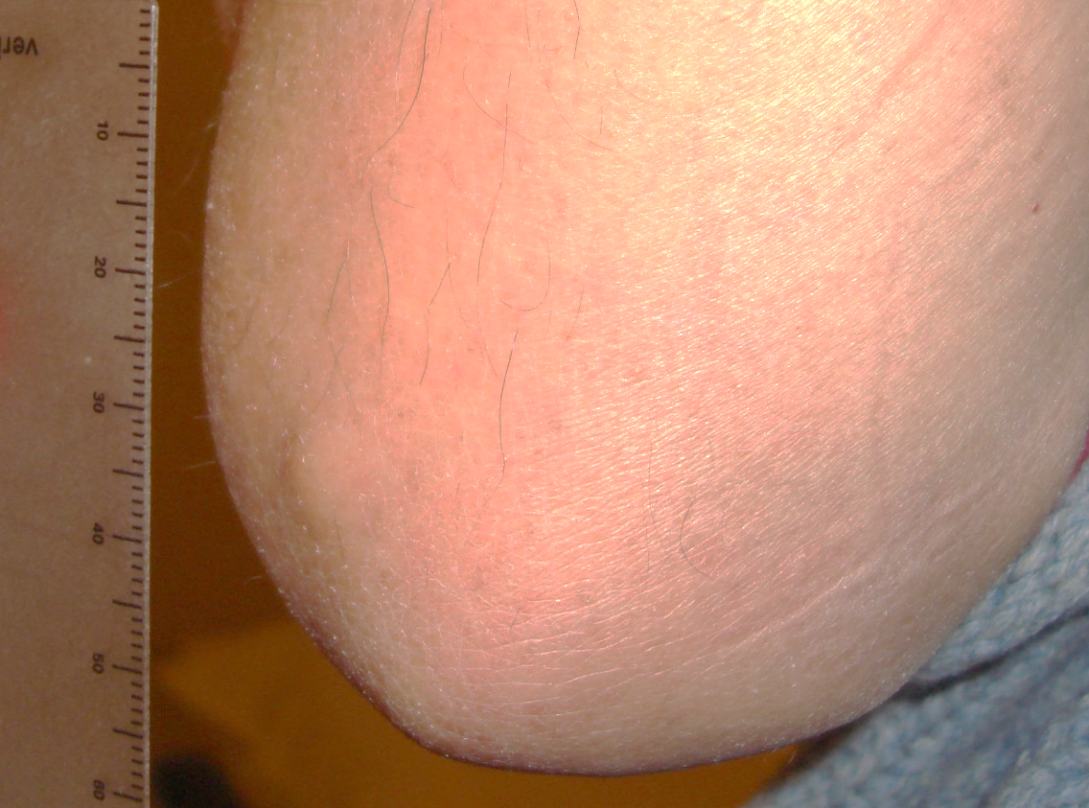
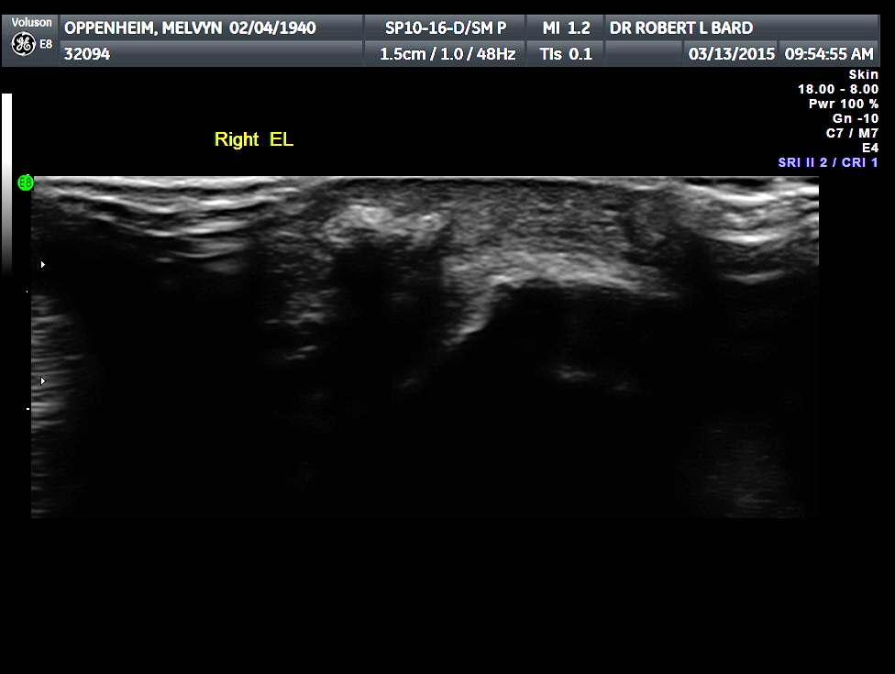
TOPHACEOUS GOUT
olecranon
75 y/o male with history of rheumatoid arthritis PMH episodes of gout

Slide 28
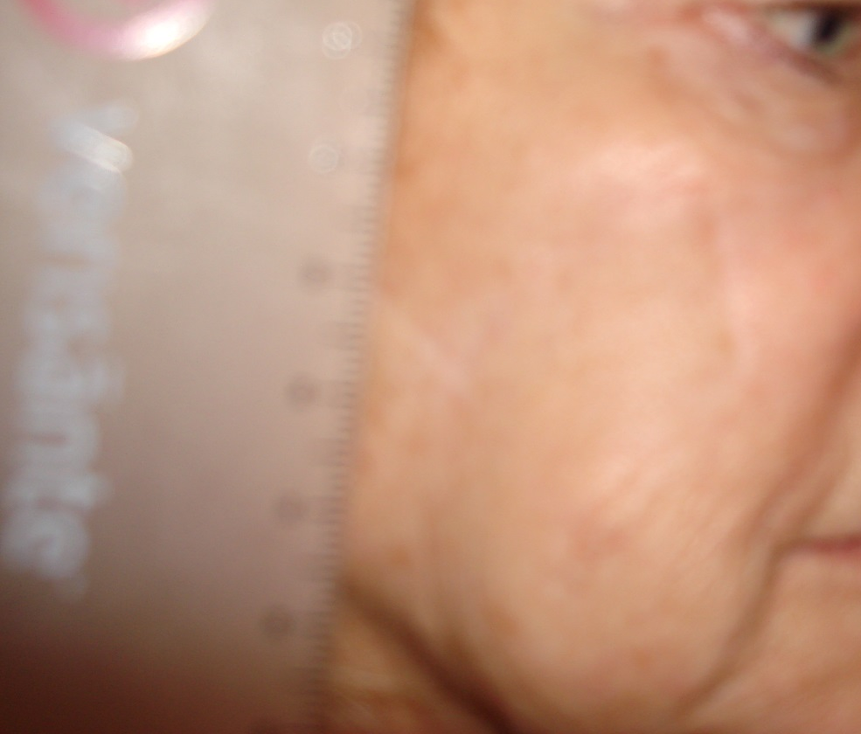
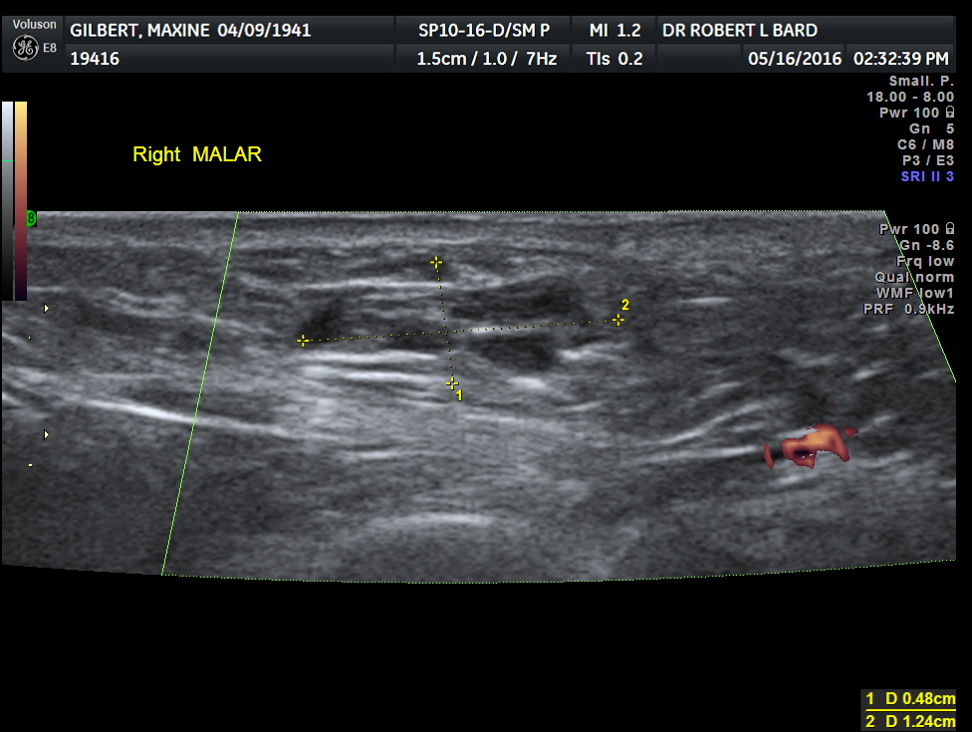
SUBDERMAL FILLER FALSE POS PET/CT SCAN
HYALURONIC FILLER 9 MONTHS BEFORE SCAN - SPO MELANOMA 9 YR

Slide 29
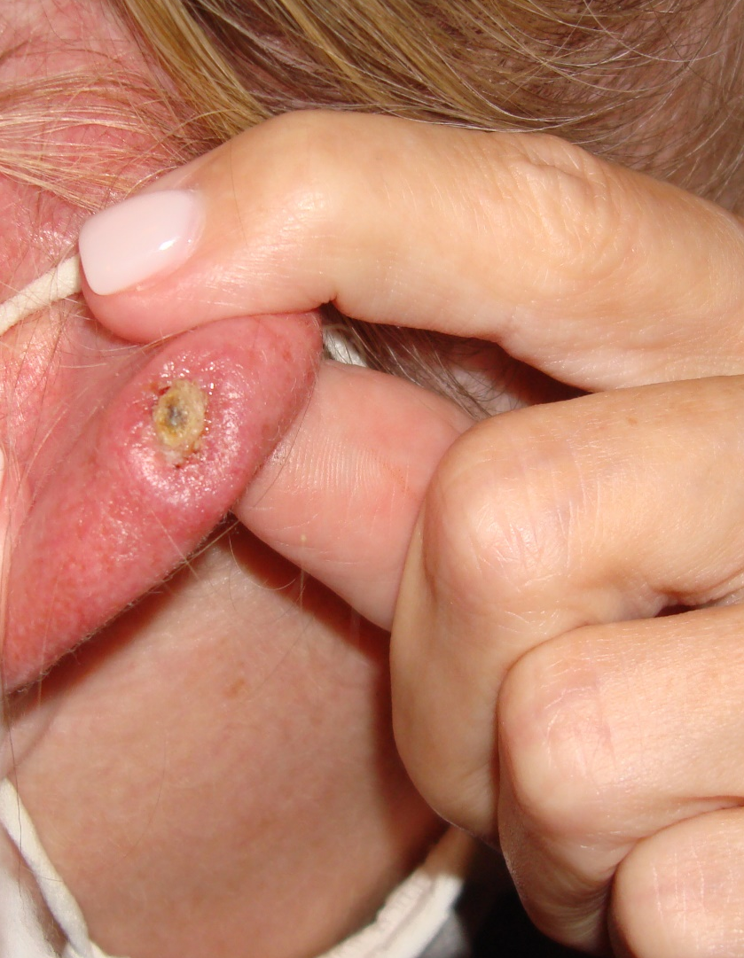
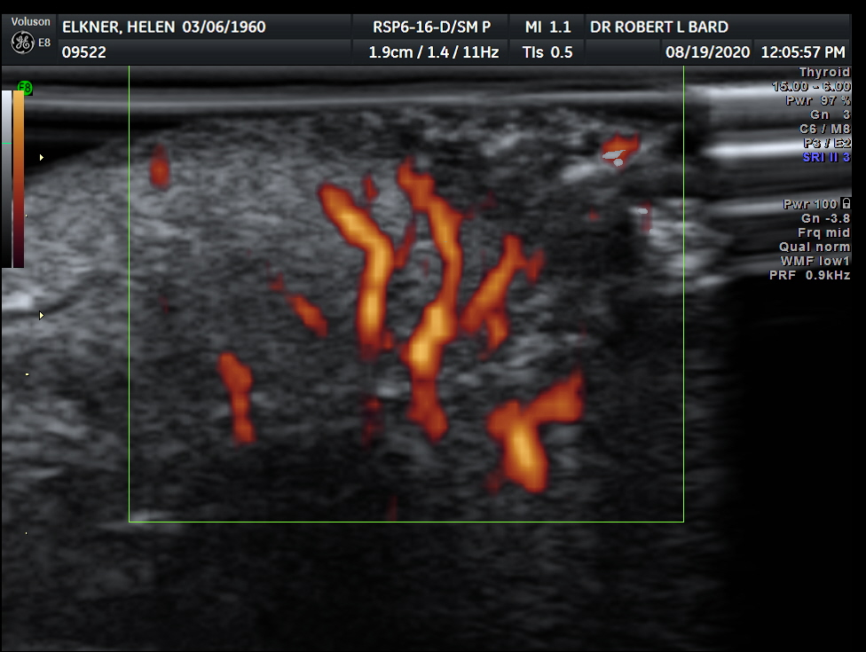
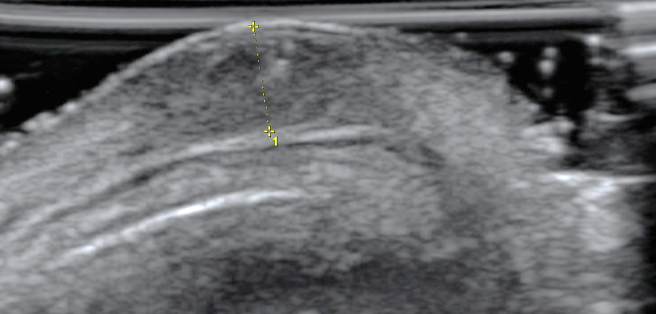
CELLULITIS MASKING SCC
1 mo post biopsy for AK
scc
inflammation
?abscess?
cartilage

Slide 30
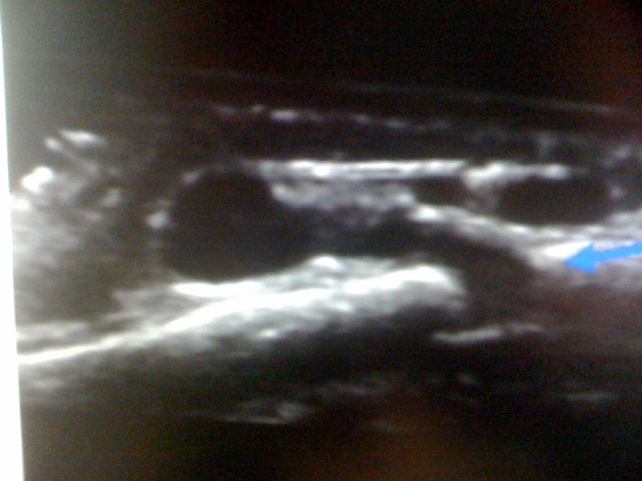
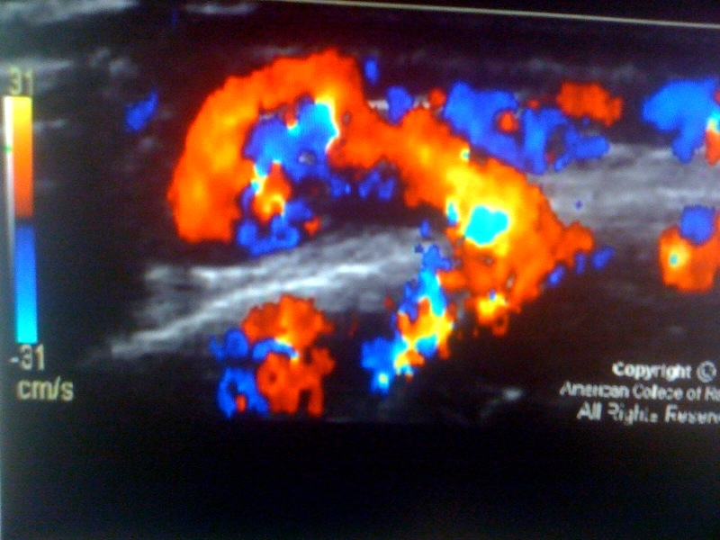
SINUS PERICRANII
MIDLINE FUSION ANOMALIES
SCALP
DEFECT
BONY CALVARIUM

Slide 31
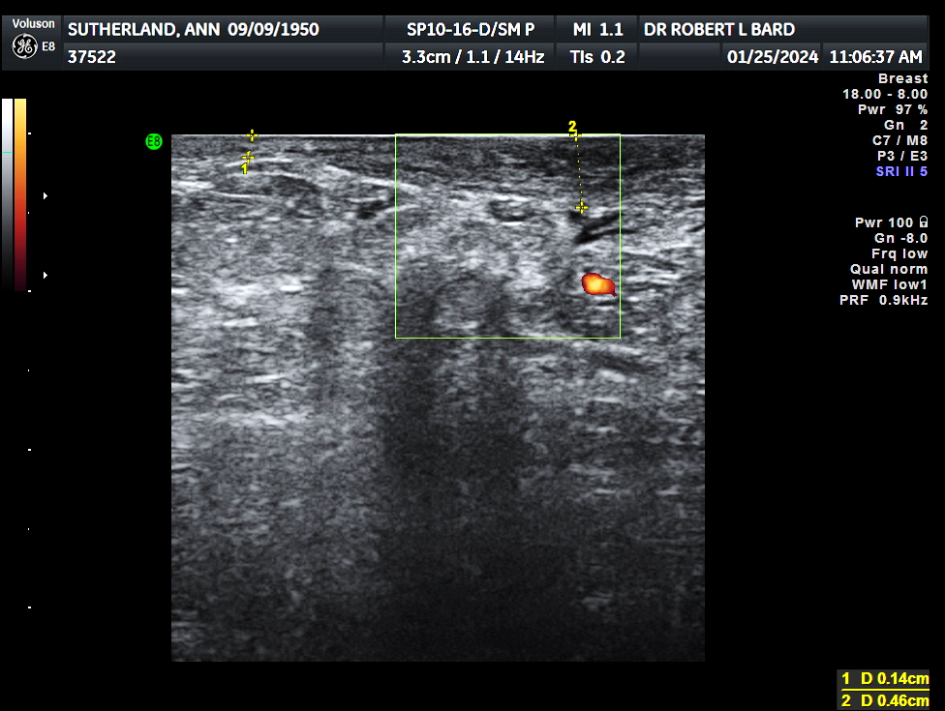
INFLAMMATORY BREAST CA

Slide 32
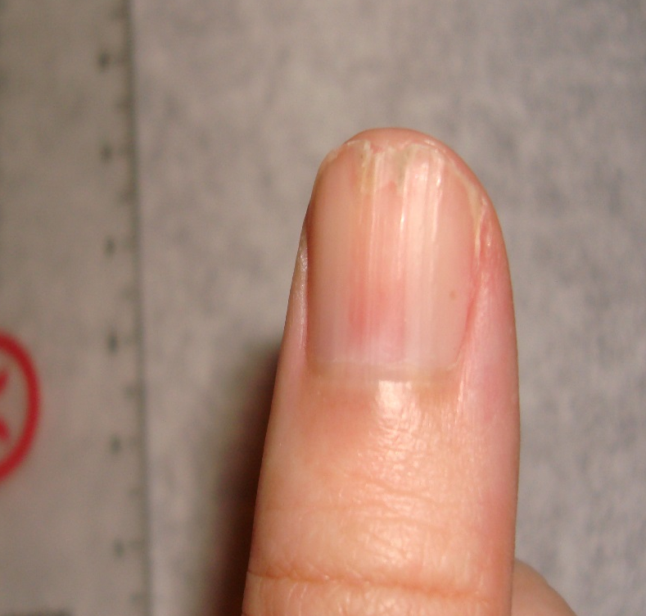
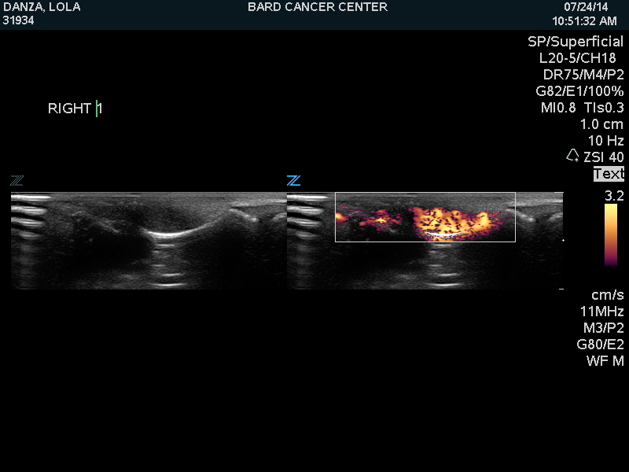
GLOMUS TUMOR
ERYTHRONYCHIA 5 YRS
CURVILINEAR BONEY REMODELLING HYPEREMIA
SONOGRAM DOPPLER SCAN

Slide 33
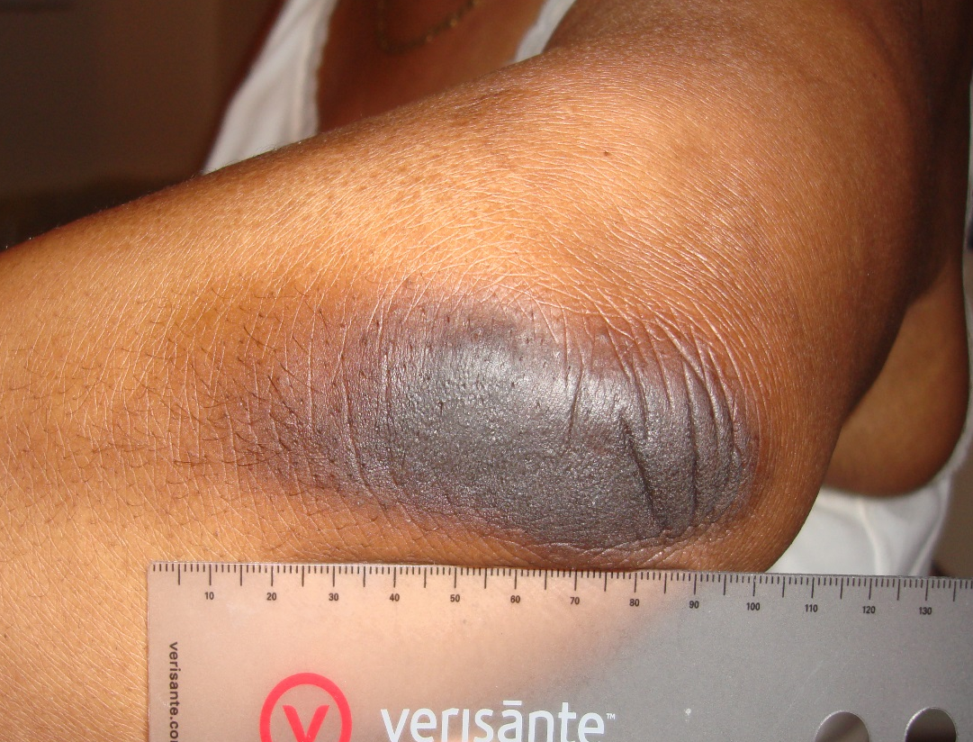
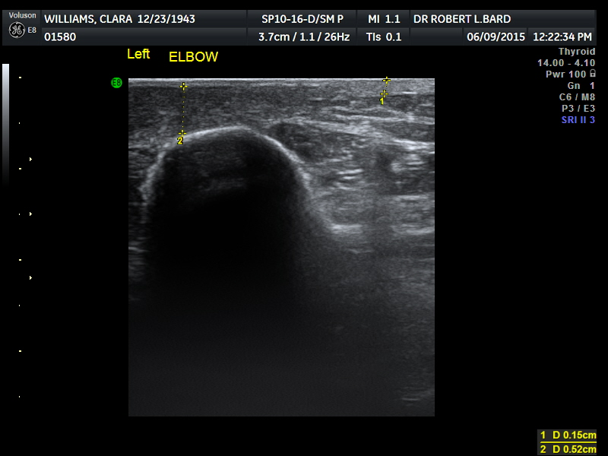
CHRONIC PSORIASIS
DERMIS
olecranon
(1) NORMAL DERMIS = 1 MM (2) THICKENED DERMIS = 3 MM

Slide 34
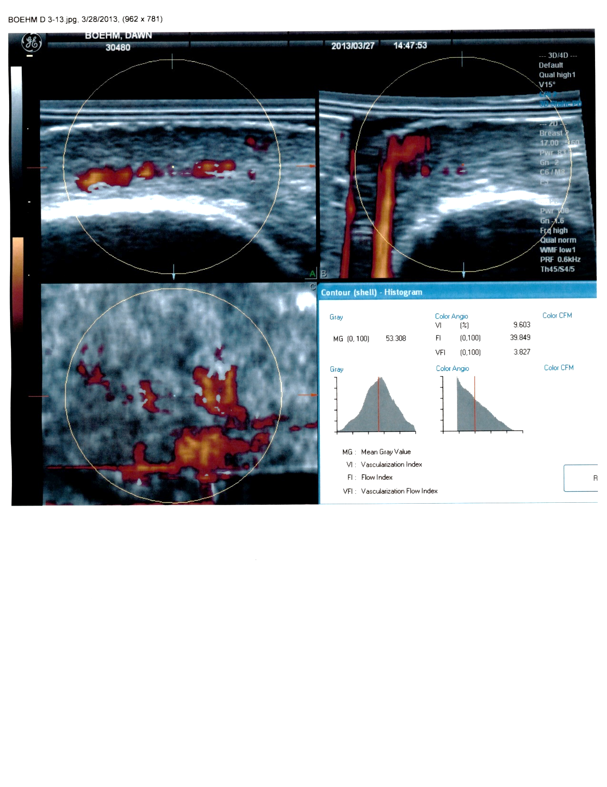
PSORIATIC VESSEL DENSITY
INFLAMATORY VESSEL DENSITY=9.6 % MAY BE FOLLOWED DURING THERAPY

Slide 35
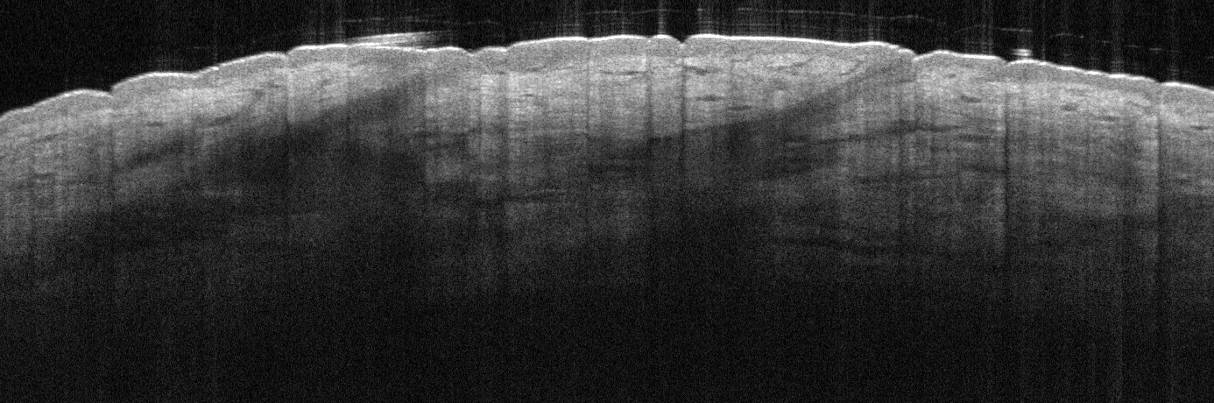
OCT ANATOMY - 1.5 mm DEPTH SCAN
epidermis
HAIR FOLLICLE
SEBACEOUS
GLAND

Slide 36
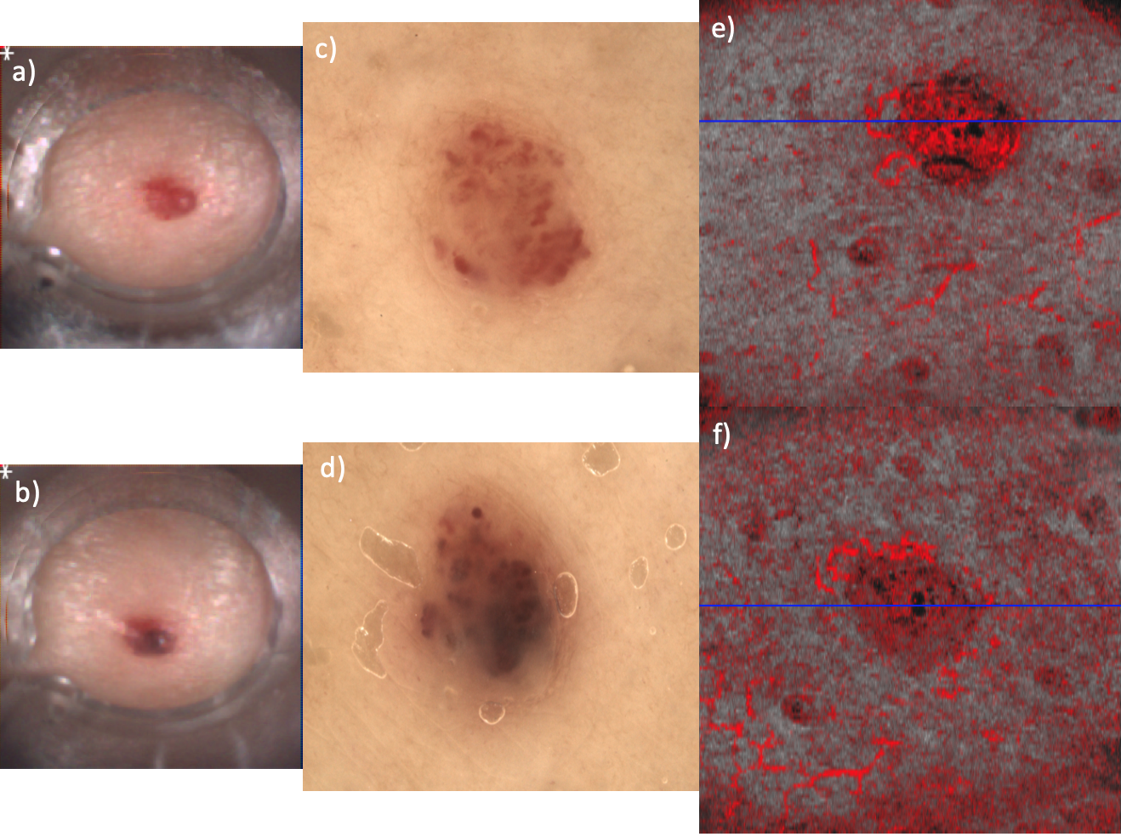
ANGIOMA: DERMOSCOPY VS ANGIO-OCT
Nd: YAG
Pre treatment
Post treatment
Courtesy: Prof. Welzel in Bard Ed: IMAGE GUIDED DERMATOLOGIC TREATMENT (Springer 2020)

Slide 37
MICROVASCULAR IMAGE GUIDED
TREATMENT OF ARTHRITIS
ROBERT BARD, MD, DABR, FAIUM, FASLMS
Director, Bard Diagnostic Imaging
THE ANGIOFOUNDATION 501(c)3, NYC
Founder
SOCIETE FRANCAISE DE RADIOLOGIE, PARIS
International Contributor
©Copyright 2024 - Robert. L. Bard, MD. All Rights Reserved.

